Slide 1
Google Guava Tranning
Power By Alex Wang, QQ:532500658
Power By: Alex Wang, QQ: 532500648

Slide 2
Agenda
1. Guava Utilites
5. Guava Cache
Joiner
Splitter
Working with Strings
Others
MapMaker/CacheBuilder
CacheLoader/CacheStats
2. Functional
6. EventBus
Function/Functions
Predicate/Predicates
Supplier/Suppliers
EventBus /AsyncEventBus
Subscribe/Finer
7. Work Files
3. Collections
hashfiles/byteSource
bytesink/closer
BaseEncoding
Lists/Sets/Maps/Multimaps
BiMap/Table/Range/Immutable
Monitor/ListenableFuture
AsyncFunction/RateLimter
4. Concurrency
Power By: Alex Wang, QQ: 532500648

Slide 3
Quick Start & Guava Utilites
01
introduce/maven/utilites
Power By: Alex Wang, QQ: 532500648

Slide 4
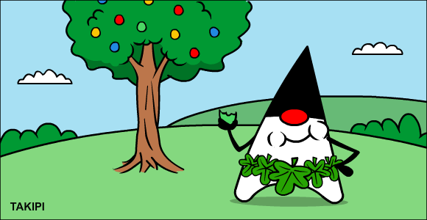
Use a well-established library instead of "rolling your own".
Starting out originally in 2007 as the "Google Collections Library"
The Google Guava project has evolved into being an essential toolkit for developers working in Java.
You are far better off using a library such as Guava, than rolling your own. Besides, according to Larry Wall (the author of Perl), one of the best qualities of a software engineer is laziness, not in the "I don't want to work" way but in the "Why reinvent the wheel when this works so well" way.
Power By: Alex Wang, QQ: 532500648

Slide 5
1. Quick Start & Guava Utilites
1. Utilites
Demonstrate the basic functionalities provided by Guava
01
Joiner
Joiners
Concatenate strings together with a specified delimiter
Splitter
04
02
Splitter
Others 04
Produce substrings broken out by the provided delimiter
Strings 03
03
Preconditions
Methods for asserting certain conditions you expect variables
Power By: Alex Wang, QQ: 532500648

Slide 6
2. Functional Programming with Guava
Function
Functional
Predicate
Functional programming emphasizes
the use of functions to achieve its objectives
versus changing state.
Supplier
Power By: Alex Wang, QQ: 532500648

Slide 7
3. Working with Files of Guava
Files
ByteSource
The Files class offers several helpful methods for working with the File objects.
A ByteSource class represents a readable source of bytes.
Closer
ByteSink
The Closer class in Guava is used to ensure that all the registered Closeable objects
A ByteSink class represents a writable source of bytes.
Power By: Alex Wang, QQ: 532500648

Slide 8
4. Google Guava EventBus
EventBus
AsyncEventBus
Events
The EventBus class is the
focal point for establishing the publish/subscribe-programming paradigm with
Guava.
The AsyncEventBus class offers the exact same functionality as the EventBus,
but uses a provided java.util.concurrent.Executor instance to execute handler
methods asynchronously.
the event is wrapped in an instance of a
DeadEvent class. Having a class that subscribes for DeadEvent instances can be
very helpful when trying to ensure that all events have registered subscribers.
Power By: Alex Wang, QQ: 532500648

Slide 9
5. Guava Concurrency
Monitor
RateLimiter
ListenableFuture
Futures
The Monitor class from Guava gives us a solution that allows multiple conditions
The RateLimiter class operates somewhat like a semaphore but instead of
restricting access by the number of concurrent threads,
The ListenableFuture
interface extends the Future interface by allowing us to register a callback to be
executed automatically once the submitted task is completed.
Futures is a utility class for working with Future instances.
Power By: Alex Wang, QQ: 532500648

Slide 10
6. Guava Caches
3
CacheLoader/CacheBuilder
Caches
In software development, caching is a very important topic.
2
Java Strong/Soft/Weak/PhantomReference
1
LRU Algorithm
Power By: Alex Wang, QQ: 532500648

Slide 11
7. Guava Collections
1. FluentIterable
5. Range
2. Lists
6. Maps
Guava
Collections
3. Sets
7. Multimaps
8. BiMap
4. Immutable collections
9. Table
Power By: Alex Wang, QQ: 532500648

Slide 12
8. The Other Courses
01
Unit Test
03
Programming
PowerMock/Mockito/Concordion
Java 8 /Java 9/Scala/Google Guava
02
Java Concurrency
04
Big Data
Thread/ThreadGroup/JUC/Concurrency Pattern
Apache Sqoop/Apache Flume
Apache Storm/Apache Zookeeper
Apache Kafka
Power By: Alex Wang, QQ: 532500648

Slide 13
THANK YOUR
Guava is a treasure worthy of your constant digging
Power By: Alex Wang, QQ: 532500648

